Slide 1
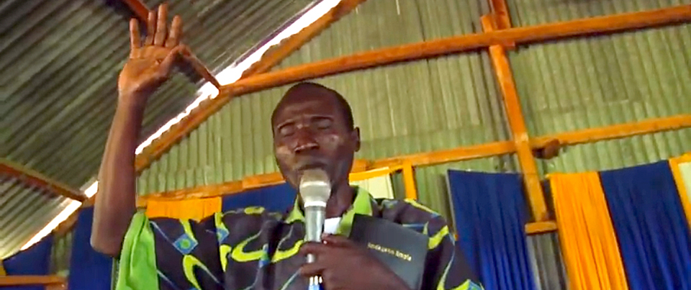
Church-Owned Bible Translation
Topic 1: Session 2

Slide 2
Bible Translation
In the Beginning:
?
With GOD, nothing is impossible!
Challenging
Unqualified
Impossible

Slide 3


God Empowers YOU So You Can Empower OTHERS!
Teach Translation
Church Team

Slide 4
Helpful Questions
What plans need to be made?
Who should be on their team?
How can you help them?

Slide 5



WA Can Help
TS@WycliffeAssociates.org
This Audio Series
Online Mentorship

Slide 6


